Slide 1
nlmixr: an open-source package for pharmacometric modelling in R
Stockholm, Sweden, June 11th 2019
Matthew Fidler
On behalf of the nlmixr development team:
Matt Fidler, Richard Hooijmaijers, Teun Post, Rik Schoemaker, Mirjam Trame, Justin Wilkins, Yuan Xiong and Wenping Wang

Slide 2
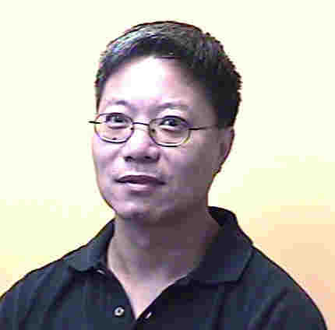
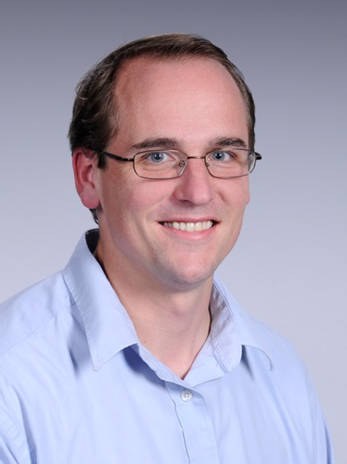
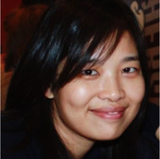
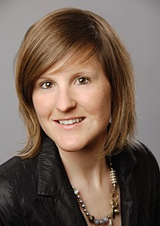
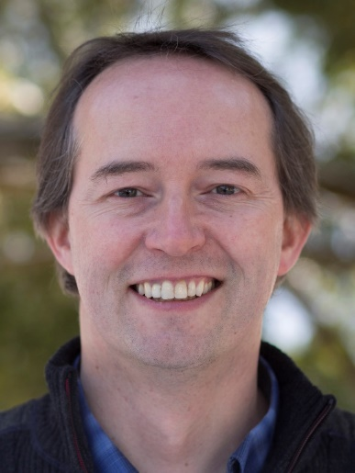



Who we are
Wenping Wang, PhD
Matthew Fidler, PhD
Yuan Xiong , PhD
Mirjam Trame, PharmD, PhD
Justin Wilkins, PhD
Rik Schoemaker, PhD
Richard Hooijmaijers, BSc
Teun Post, PharmD, PhD

Slide 3


Vision of
To develop an R-based open-source nonlinear mixed-effects modeling software package that can compete with commercial pharmacometric tools and is suitable for regulatory submissions

Slide 4
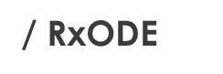
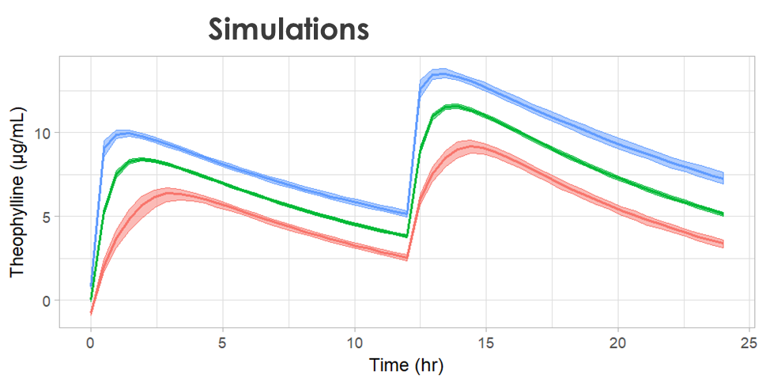
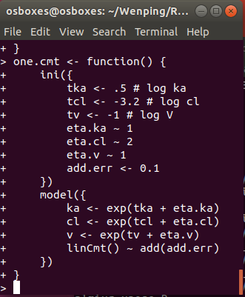
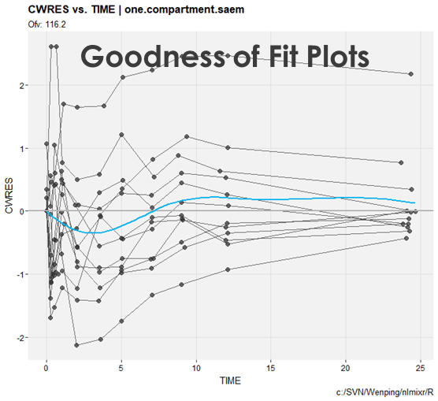

Outline
Model Syntax

Slide 5
modelling syntax, running nlmixr models and nlmixr output

Slide 6
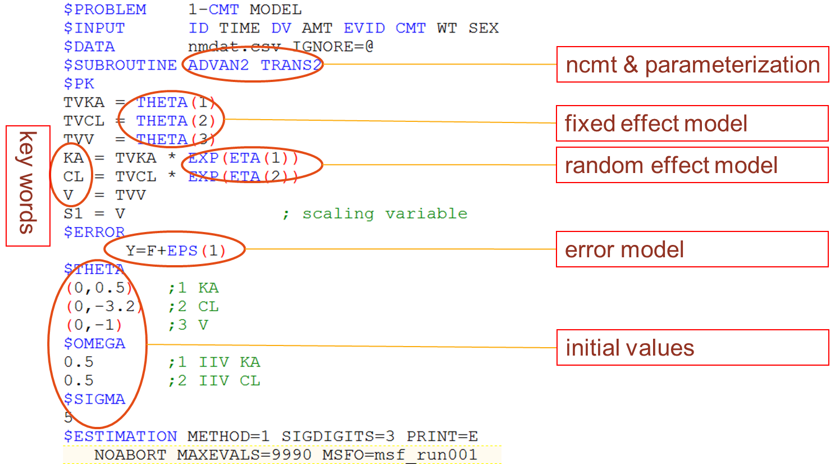
Anatomy of a NONMEM control stream for a popPK model

Slide 7
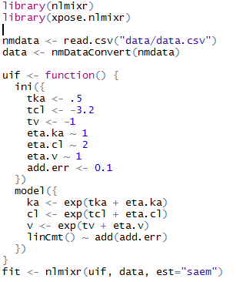
Anatomy of a nlmixr control stream for a popPK model compared to NONMEM
NONMEM Dataset
NONMEM $PK like
Initial values for fixed effects
Initial values for random effects
Initial values for error model
ADVAN & TRANS like

Slide 8
A nlmixr model has two main parts: initialisation and model
Initialisation ini({ }) | Model model({ })
Relationship of Fixed/Random Pars First
Labeled with #
model({
Cl = exp(lCl + eta.Cl)
Vc = exp(lVc + eta.Vc)
KA = exp(lKa + eta.Ka)
})
Parameters defined based on ini block
Fixed/Random relationships defined first
Model (Solved/RxODE) defined next
Unexplained error defined by formula (~)
ini({
lCl = 1.6 #log Cl (L/hr)
lVc = log(90) #log V (L)
lKa = fix(1) #log Ka (1/hr)
add.sd = 0.2
eta.Ka ~ 0.1 #IIV Ka
eta.Cl + eta.Vc ~ c(0.1,
0.005, 0.1)
})
linCmt() ~ add(add.sd)
Lower triangular block matrix
Population and Residual Estimates are defined using assign operators (=)
Random Effects (ETAs) defined using a model formula (~; aka modelled by)

Slide 9
nlmixr uses defined parameters to select 1, 2 or 3 solved compartment model with linCmt() → closed-form solutions
Solved System Parameterization Support | Model model({ })
1 Compartment | 2 Compartment | 3 Compartment
Cl, V | Cl, V, Q, Vp | Cl, Vc, Q1, Vp1, Q2 Vp2
Kel, V | Kel, k12, k21, V | Kel, k12, k21, k13, k31, V
A, alpha | A, alpha, B, beta | A, alpha, B, beta, C, gamma
model({
Cl = exp(lCl + eta.Cl)
Vc = exp(lVc + eta.Vc)
KA = exp(lKa + eta.Ka)
})
Vp = exp(lVp)
Cld = exp(lCld)
linCmt() ~ prop(prop.sd)
nlmixr also uses parameter aliases; Examples:
V =Vc = V1 and Q = Cld.
Parameter case does not matter
Parameter aliases are context dependent.
The first can be Volume = Vc, (Can start with V2)
Second numbered Volume = Vp
All NONMEM style parameters are supported.
CMT #1 = depot (w/Ka) / central (without Ka) compartment
1 compartment solved model is specified by linCmt()
2 and 3 compartment model is also specified by linCmt()
Type of model depends on provided parameters
https://nlmixrdevelopment.github.io/RxODE/articles/RxODE-model-types.html#solved-compartment-models

Slide 10
A nlmixr model block in case of no closed-form solution or PD model and ODE model block is required → linCmt cannot be used
Initialisation ini({ }) | Model model({ })
model({
Cl = exp(lCl + eta.Cl)
Vc = exp(lVc + eta.Vc)
KA = exp(lKa + eta.Ka)
})
Parameters defined based on ini block
Fixed/Random relationships defined first
Model (Solved/RxODE) defined next
Unexplained error defined by formula (~)
Labeled with #
Relationship of Fixed/Random Pars First
ini({
lCl = 1.6 #log Cl (L/hr)
lVc = log(90) #log V (L)
lKa = 1 #log Ka (1/hr)
prop.sd = 0.2
eta.Ka ~ 0.1 #IIV Ka
eta.Cl + eta.Vc ~ c(0.1,
0.005, 0.1)
})
kel = Cl / Vc
d/dt(depot) = -KA*depot
d/dt(centr) = KA*depot-kel*centr
cp = centr / Vc
Lower triangular block matrix
instead of linCMT
cp ~ prop(prop.sd)
Population and Residual Estimates are defined using assign operators (=)
Random Effects (ETAs) defined using a model formula (~; aka modelled by)

Slide 11
Add lag time (alag) to the model
Initialisation ini({ }) | Model model({ })
Relationship of Fixed/Random Pars First
ini({
lCl = 1.6 #log Cl (L/hr)
lVc = log(90) #log V (L)
lKa = 1 #log Ka (1/hr)
lalag = log(0.5)
prop.sd = 0.2
eta.Ka ~ 0.1 #IIV Ka
eta.Cl + eta.Vc ~ c(0.1,
0.005, 0.1)
})
model({
Cl = exp(lCl + eta.Cl)
Vc = exp(lVc + eta.Vc)
KA = exp(lKa + eta.Ka)
lagD = exp(lalag)
})
Labeled with #
kel = Cl / Vc
d/dt(depot) = -KA*depot
alag(depot) = lagD
d/dt(centr) = KA*depot-kel*centr
cp = centr / Vc
cp ~ prop(prop.sd)
Lower triangular block matrix
Population and Residual Estimates are defined using assign operators (=)
Random Effects (ETAs) defined using a model formula (~; aka modelled by)

Slide 12
Add Bioavailability (F) and lag time (alag) to the model
Initialisation ini({ }) | Model model({ })
Relationship of Fixed/Random Pars First
ini({
lCl = 1.6 #log Cl (L/hr)
lVc = log(90) #log V (L)
lKa = 1 #log Ka (1/hr)
lf = log(1)
lalag = log(0.5)
prop.sd = 0.2
eta.Ka ~ 0.1 #IIV Ka
eta.Cl + eta.Vc ~ c(0.1,
0.005, 0.1)
})
model({
Cl = exp(lCl + eta.Cl)
Vc = exp(lVc + eta.Vc)
KA = exp(lKa + eta.Ka)
fD = exp(lf)
lagD = exp(lalag)
})
Labeled with #
kel = Cl / Vc
d/dt(depot) = -KA*depot
alag(depot) = lagD
f(depot) = fD
d/dt(centr) = KA*depot-kel*centr
cp = centr / Vc
cp ~ prop(prop.sd)
Lower triangular block matrix
Population and Residual Estimates are defined using assign operators (=)
Random Effects (ETAs) defined using a model formula (~; aka modelled by)

Slide 13
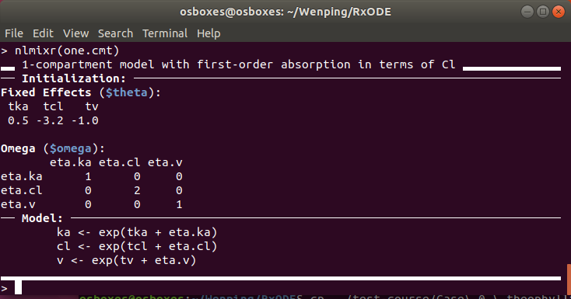
Finalising and checking a nlmixr model verifies nlmixr detects the correct solved model (or RxODE model), as well as showing the parsed initial estimates
Finalising models | Checking how the model is parsed
To finalize a model, put the ini and model in a named function
By calling nlmixr on the named R function, it will tell you how nlmixr parsed the model; This is especially useful in checking what solved system nlmixr detected before running the entire model

Slide 14
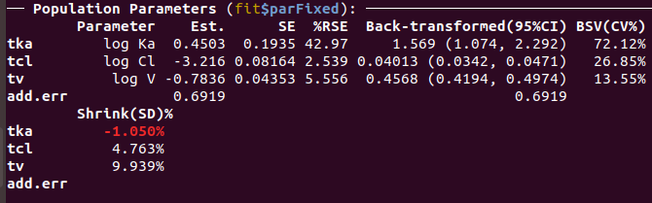
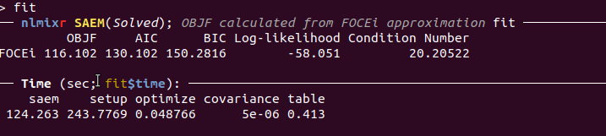
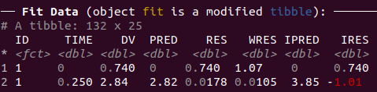
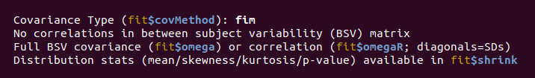
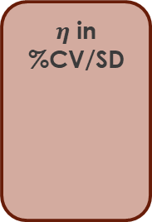
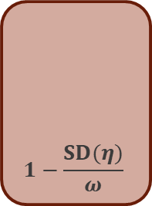
Fitting nlmixr models takes the estimation method (with its options) and produces a nlmixr combined dataset/fit object
Assigned R object
Estimation methods = (“nlme”, “saem”, “focei”, “foce”, “foi”, “fo”)
Optional if cwres and or npde calculations wanted
fit <- nlmixr(one.cmt, data, est = "saem", table=tableControl(cwres=TRUE, npde=TRUE))
Function Name is run name
# Labels
$η$ in %CV/SD
Model Based
Est.
Transformed to be on “natural” scale. CIs are on the same scale
$$1−\frac{SD(η)}{ω}$$

Slide 15
Residual Error models and Multiple Endpoints
Error Model | Coding | Supported By
Additive/Normal | Y ~ add(add.sd) | nlme, fo, foi, foce, focei, saem
Proportional | Y ~ prop(prop.sd) | nlme, fo, foi, foce, focei, saem
Additive + Proportional | Y ~ add(add.sd) + prop(prop.sd) | nlme, fo, foi, foce, focei, saem
Lognormal/Exponential Note: normal scale OBJF | Y ~ lnorm(lnorm.sd) | fo, foi, foce, focei
Power Model | Y ~ pow(pow.sd, pow) | fo, foi, foce, focei
Additive + Power | Y ~ add(add.sd) + pow(pow.sd, d) | fo, foi, foce, focei
Cox-Box transform both sides | Y ~ add(add.sd) + coxBox(lambda) | fo, foi, foce, focei
Yeo-Johnson transform both sides | Y ~ add(add.sd) + yeoJohnson(lambda) | fo, foi, foce, focei
Bernoulli | p ~ bern() | saem
Poisson | lambda ~pois() | saem
Multiple Endpoint:
PK ~ add(add.sd) + prop(prop.sd) | depot
PD ~ add(pd.sd) | err

Slide 16
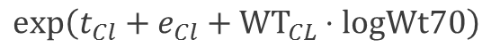
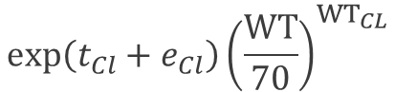
Inclusion of Covariates into a SAEM nlmixr model
Initialization ini({ })
ini({
lCl = 1.6 #log Cl (L/hr)
lVc = log(90) #log V (L)
lKa = fix(1) #log Ka (1/hr)
beta.wt = 0.75 #estimate of covariate effect
prop.sd = c(0,0.2,1)
eta.Ka ~ 0.1 #IIV Ka
eta.Cl + eta.Vc ~ c(0.1, 0.005, 0.1)
})
Random or Individual Parameter
$${exp⁡\left(t_{Cl}+e_{Cl}\right)\left(\frac{WT}{70}\right)}^{{WT}_{CL}}$$
Cl = exp( tCl + eta.Cl + beta.wt * lnWt70 )
Fixed or Population Parameter
Covariate Estimate times transformed covariate
$$exp⁡\left(t_{Cl}+e_{Cl}+{WT}_{CL}⋅logWt70\right)$$

Slide 17
Overview of non-linear mixed effect model algorithms in nlmixr:
First Order with FOCEi posthoc (foi) or FOCE posthoc (fo)
First Order Conditional Estimate (FOCE)
First Order Conditional Estimate with interaction (FOCEi)
Stochastic Approximation Estimation-Maximization (SAEM)
Adaptive Gaussian quadrature (with Laplacian approximation as a special case see glmn and glmm2)
Traditional R nlme
## eg nlmixr(modelfn, data, "foi");
## eg nlmixr(modelfn, data, "fo");
## eg nlmixr(modelfn, data, "foce");
## eg nlmixr(modelfn, data, "focei");
## eg nlmixr(modelfn, data, "saem");
## eg nlmixr(modelfn, data, "nlme");

Slide 18
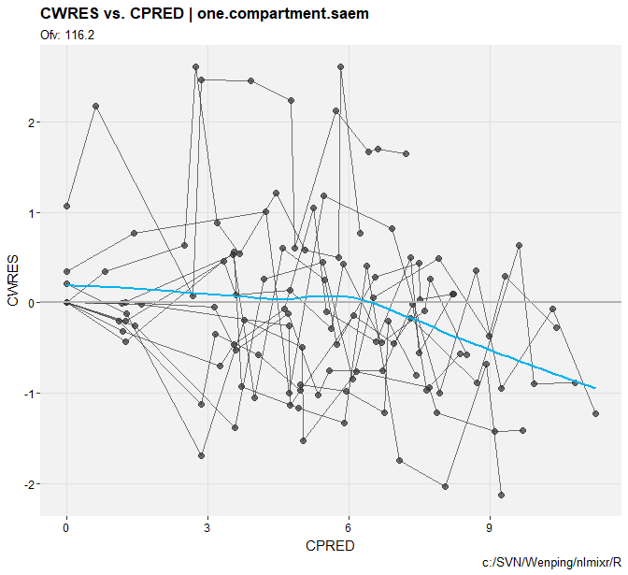
diagnostic plots from a nlmixr model

Slide 19


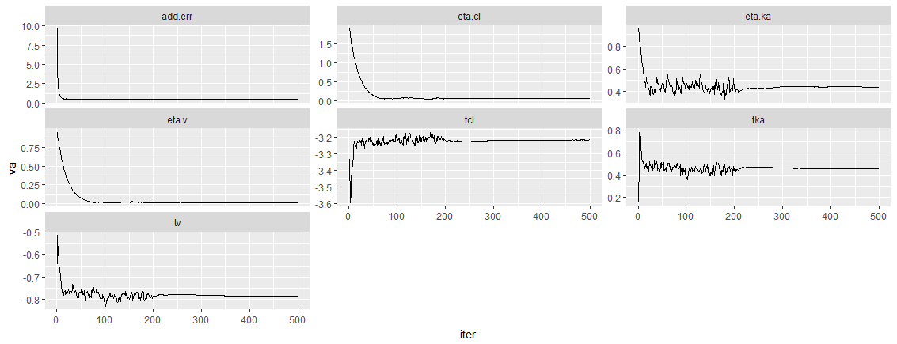
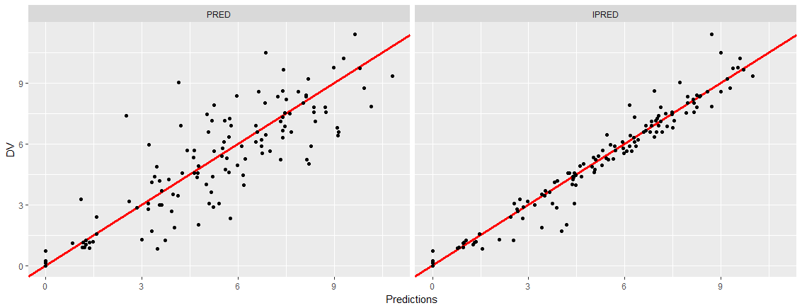
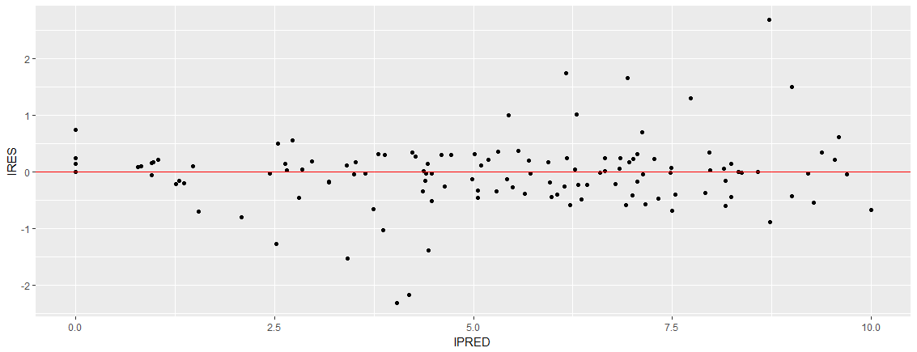
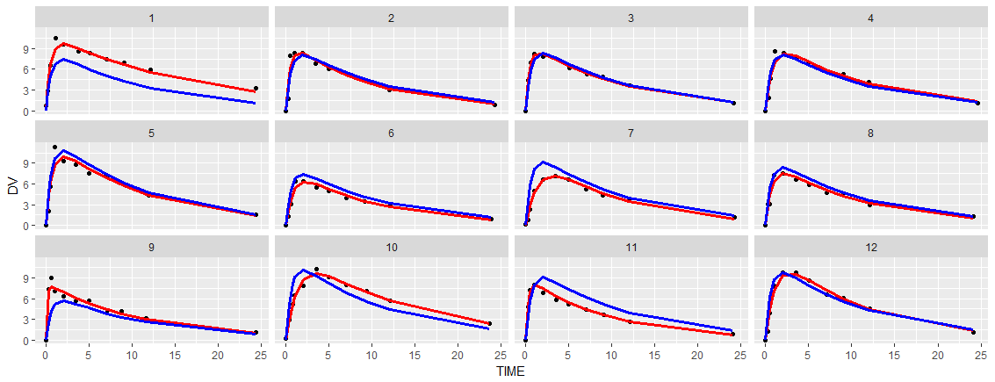
Simple goodness of fit plots can be produced by a simple plot(fit)
traceplots
DV/PRED or IPRED
residuals
Individual plots

Slide 20

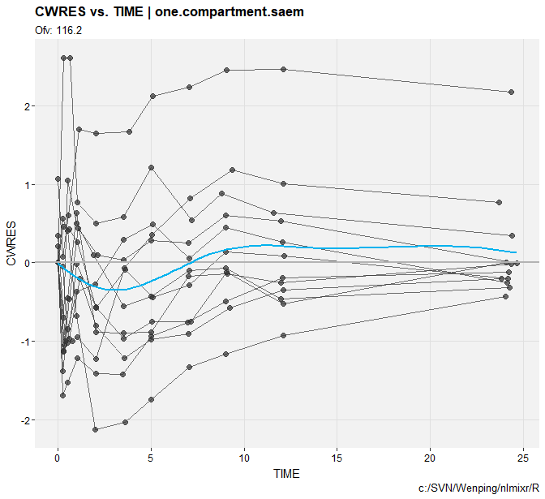
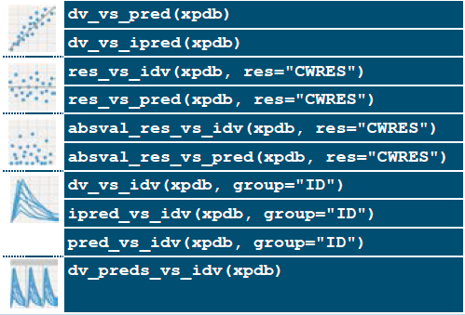
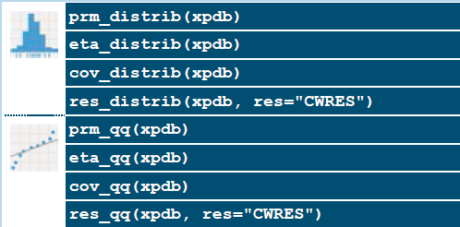
Xpose Plots can be created by converting fit to xpose data
xpdb<-xpose_data_nlmixr(fit,xp_theme= theme_xp_nlmixr())
res_vs_idv(xpdb)
res_vs_pred(xpdb)

Slide 21

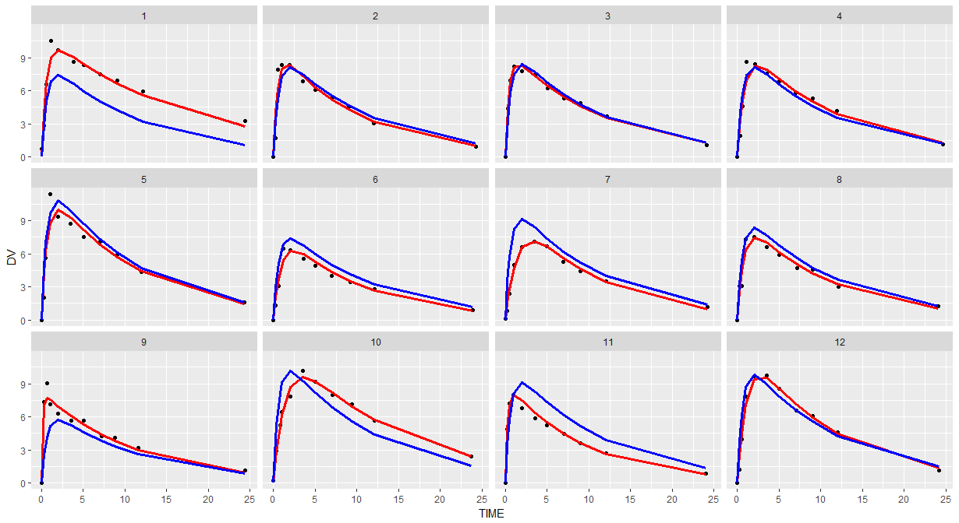
Individual Plots Using Fit Data Shows observations & connects the dots for individual points
ggplot(fit,aes(TIME, DV)) + geom_point() + facet_wrap(~ID) + geom_line(aes(TIME,IPRED),col="red",size=1.2) + geom_line(aes(TIME,PRED),col="blue",size=1.2);

Slide 22
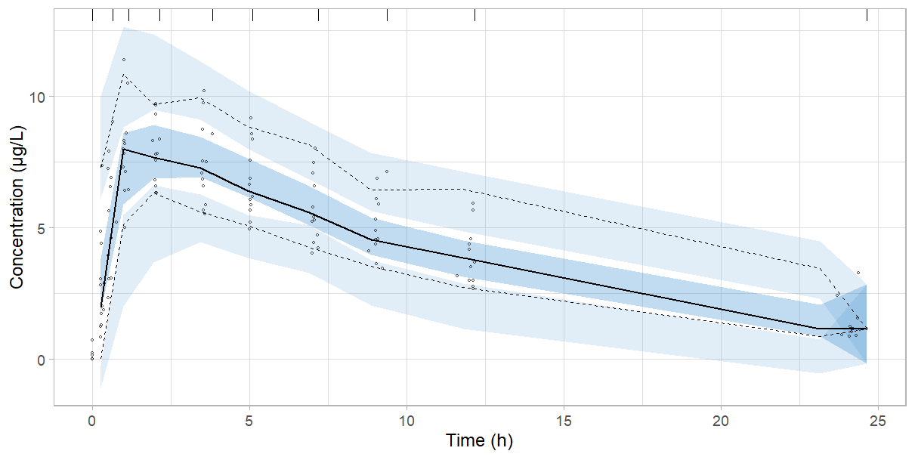
Model Evaluation with Visual Predictive Check
Simple syntax
Only requires fit
?vpc_ui for more options
Saves Simulation, summary etc
Return has simulation & gg plot
vpc.ui(fit, n=600,show=list(obs_dv=T), log_y=T, xlab="Time (h)", ylab="Concentration (\u03BCg/L)")$gg + theme_light(base_size=18)
https://github.com/ronkeizer/vpc

Slide 23

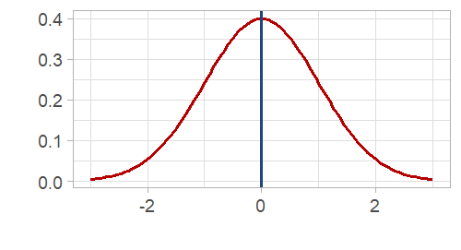
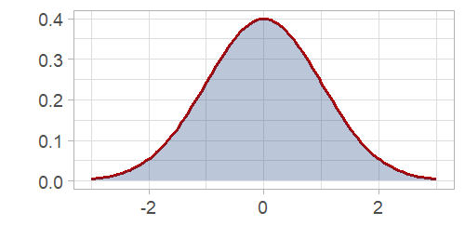
simulating from a nlmixr model
multi-subject
Without uncertainty
With uncertainty

Slide 24
Excursion to RxODE https://nlmixrdevelopment.github.io/RxODE/

Slide 25
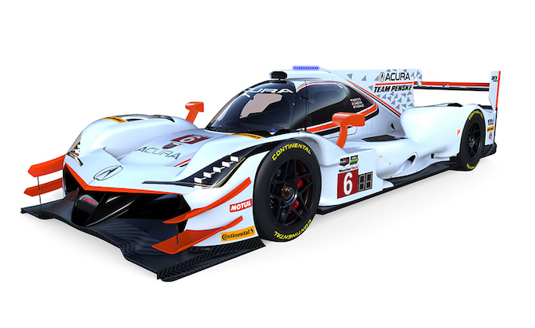
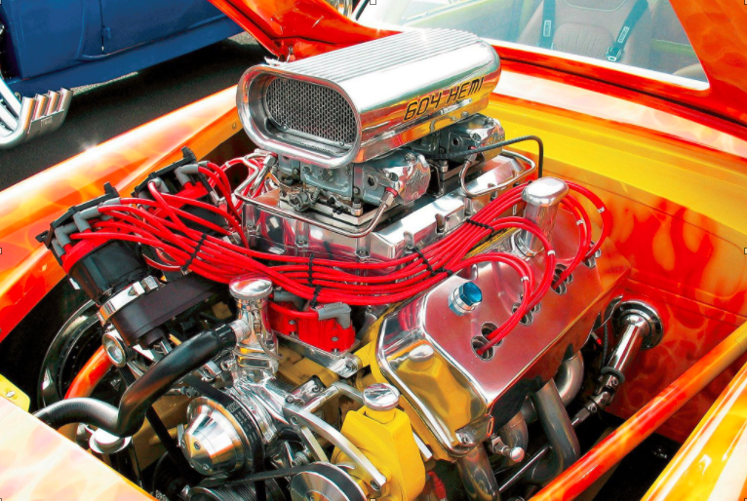
RxODE is the ODE solving engine that powers the estimation methods of nlmixr
Solve ODEs
Estimate Parameters
What do I need to know about RxODE?
What in RxODE is used by nlmixr?
What in RxODE is output by nlmixr?

Slide 26
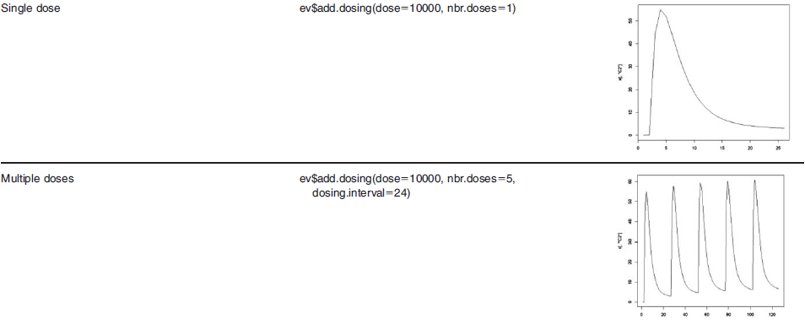
Specify a variety of dosing schedules using the add.dosing() function
Can also use NONMEM-style events by et
et(amt=10000)
Can also use NONMEM-style events by et
et(amt=10000, addl=4, ii=24)
Wang W. et al. A Tutorial on RxODE: Simulating Differential Equation Pharmacometric Models in R. CPT:PSP (2016)5,3-10

Slide 27
Creating an eventTable with et(), add.sampling(), add.dosing()
add.sampling = function( | Sampling Times ) | et = function( | Sampling times)
add.dosing = function( |  | et = function(
dose, | # dose amount | amt, | # dose amount
nbr.doses, | # number of doses | addl, | # additional doses nbr.doses – 1
dosing.interval=24, | # dosing interval | ii, | # dosing interval
dosing.to=1, | # where to dose | cmt, | # where to dose
rate=NULL, | # infusion rate | rate | # infusion rate
start.time=0 | # dosing start time | time | # dosing start time
) |  | )
add.dosing(), add.sampling() or et() can be called incrementally multiple times
ev <- eventTable(amount.units="mg", time.units="hours") %>%
add.dosing(dose=10000, nbr.doses=10, dosing.interval=12) %>%
add.dosing(dose=20000, nbr.doses=5,
start.time=120,dosing.interval=24) %>%
add.sampling(0:240);

Slide 28
Back to Simulating with nlmixr

Slide 29
Simulating using nlmixr Simulate a new regimen (BID) – No Parameter Uncertainty
Load nlmixr | library(nlmixr)
Specify ODE models | model({ C2 = centr/V2; d/dt(depot) =-KA*depot; d/dt(centr) = KA*depot - CL*C2; })
Specify Dosing & Sampling | ev <- eventTable()# For nlmixr & RxODE simulations ev$add.dosing(dose=4.7,nbr.doses=2,dosing.interval=12) #assume BID ev$add.sampling(seq(0,24,length.out=51))
Simulate Events | n <- 300 bid <- simulate(fit, events=ev, nSub=n*n)
Solved RxODE Object
Simulation Output: sim.id, time, ipred, sim
nlmixr Object

Slide 30
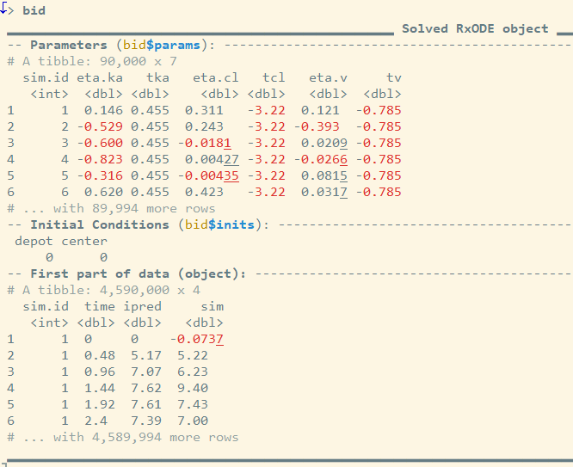
Simulation Output The simulation has information about the parameters that were used in the simulation from the model fit (= Solved RxODE object)
Constant Population Parameters
> summary(bid$params)
sim.id eta.ka tka eta.cl
Min. : 1 Min. :-2.9624044 Min. :0.4546 Min. :-1.2343951
1st Qu.:22501 1st Qu.:-0.4482224 1st Qu.:0.4546 1st Qu.:-0.1794427
Median :45001 Median :-0.0005998 Median :0.4546 Median : 0.0010281
Mean :45001 Mean :-0.0018905 Mean :0.4546 Mean : 0.0005723
3rd Qu.:67500 3rd Qu.: 0.4434868 3rd Qu.:0.4546 3rd Qu.: 0.1824282
Max. :90000 Max. : 2.7591093 Max. :0.4546 Max. : 1.1282721
tcl eta.v tv
Min. :-3.215 Min. :-0.5714017 Min. :-0.7848
1st Qu.:-3.215 1st Qu.:-0.0895164 1st Qu.:-0.7848
Median :-3.215 Median : 0.0009726 Median :-0.7848
Mean :-3.215 Mean : 0.0008345 Mean :-0.7848
3rd Qu.:-3.215 3rd Qu.: 0.0919098 3rd Qu.:-0.7848
Max. :-3.215 Max. : 0.5585632 Max. :-0.7848

Slide 31

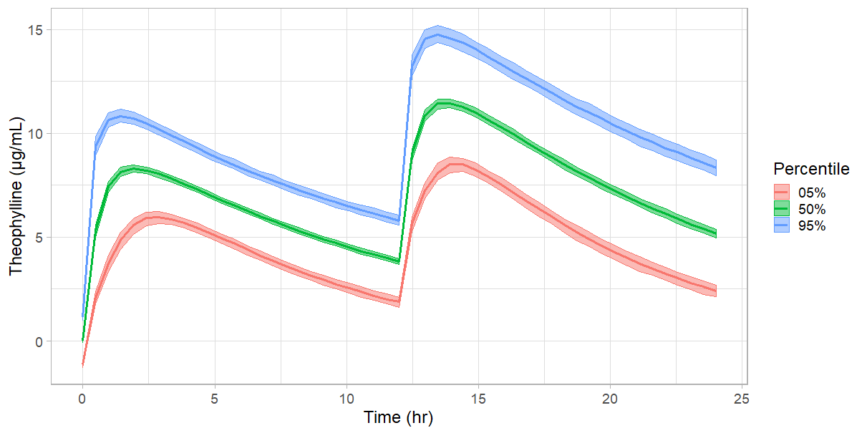
Simulate a new regimen (BID) – No Parameter Uncertainty
→ Simulation Plot
plot(bid) +
ylab("Theophylline (\u03BCg/mL)")+
xlab("Time (hr)")+
theme_light(base_size=18)

Slide 32
Simulating using nlmixr Simulate a new regimen (BID) – With Parameter Uncertainty → add one additional parameter “nStud”
Load nlmixr | library(nlmixr)
Specify ODE models | model({ C2 = centr/V2; d/dt(depot) =-KA*depot; d/dt(centr) = KA*depot - CL*C2; })
Specify Dosing & Sampling | ev <- eventTable()# For nlmixr & RxODE simulations ev$add.dosing(dose=4.7,nbr.doses=2,dosing.interval=12) #assume BID ev$add.sampling(seq(0,24,length.out=51))
Simulate Events | n <- 300 bid <- simulate(fit, events=ev, nSub=n, nStud=n)
Solved RxODE Object
nStud = # of “Studies” sampled
nSub = # subjects per study
nlmixr Object
Simulation Output: sim.id, time, ipred, sim

Slide 33
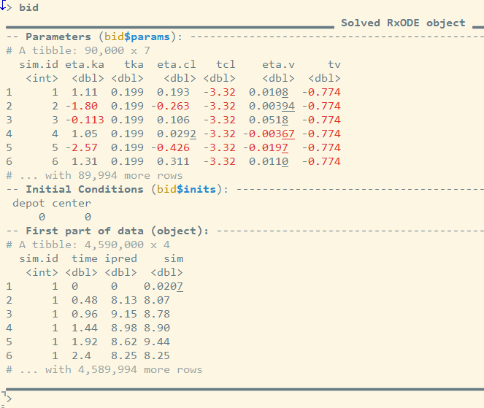
Simulation Output The simulation has information about the parameters that were used in the simulation from the model fit (= Solved RxODE object)
Changing Population Parameters
> summary(bid$params)
sim.id eta.ka tka eta.cl
Min. : 1 Min. :-5.910739 Min. :-0.09778 Min. :-1.3511807
1st Qu.:22501 1st Qu.:-0.363984 1st Qu.: 0.30723 1st Qu.:-0.0734019
Median :45001 Median : 0.001011 Median : 0.45434 Median :-0.0004093
Mean :45001 Mean : 0.001559 Mean : 0.43990 Mean :-0.0007771
3rd Qu.:67500 3rd Qu.: 0.364199 3rd Qu.: 0.56614 3rd Qu.: 0.0724550
Max. :90000 Max. : 6.003083 Max. : 0.94869 Max. : 1.7316982
tcl eta.v tv
Min. :-3.435 Min. :-1.0236210 Min. :-0.9172
1st Qu.:-3.263 1st Qu.:-0.0250715 1st Qu.:-0.8122
Median :-3.213 Median :-0.0000393 Median :-0.7860
Mean :-3.212 Mean : 0.0000356 Mean :-0.7848
3rd Qu.:-3.160 3rd Qu.: 0.0252582 3rd Qu.:-0.7530
Max. :-2.954 Max. : 0.8727193 Max. :-0.6597

Slide 34
The “Study” realization of each “omega” matrix and “sigma” matrix can also be accessed
> head(bid$omega.list,3)
[[1]]
[,1] [,2] [,3]
[1,] 1.241368413 0.20987892 0.008933452
[2,] 0.209878919 0.11947895 0.012484270
[3,] 0.008933452 0.01248427 0.018430285
[[2]]
[,1] [,2] [,3]
[1,] 1.37419522 0.09899824 0.01474735
[2,] 0.09899824 0.07532544 -0.01726544
[3,] 0.01474735 -0.01726544 0.01979003
[[3]]
[,1] [,2] [,3]
[1,] 0.55100595 0.04605451 0.01535430
[2,] 0.04605451 0.11197438 -0.01655395
[3,] 0.01535430 -0.01655395 0.01563234
> head(bid$sigma.list,3)
[[1]]
[,1]
[1,] 0.5943641
[[2]]
[,1]
[1,] 0.5408789
[[3]]
[,1]
[1,] 0.4281149
Sampled from Inverse Wishart (Scaled), df=#Obs
Sampled from Inverse Wishart (Scaled), df=#Sub

Slide 35
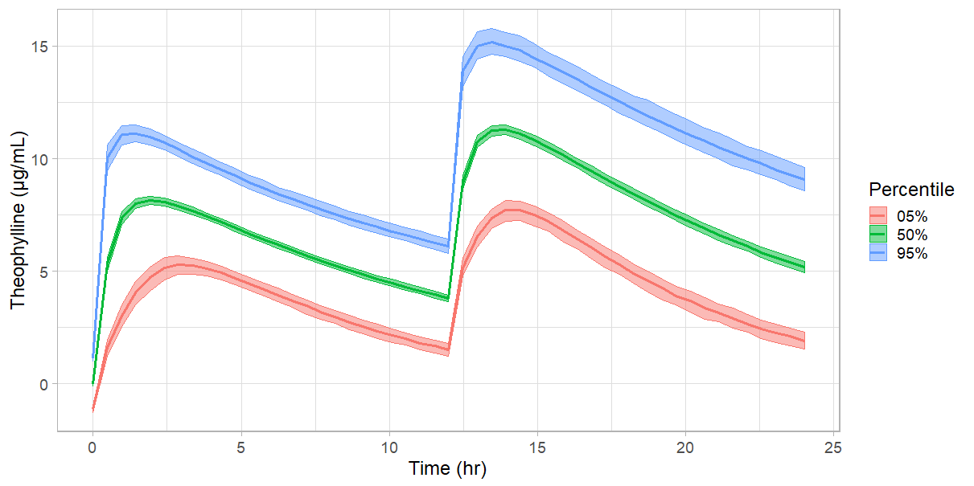
Simulate a new regimen (BID) – With Parameter Uncertainty → Simulation Plot
Higher Absorption Uncertainty
plot(bid) +
ylab("Theophylline (\u03BCg/mL)")+
xlab("Time (hr)")+
theme_light(base_size=18)

Slide 36
Hands-on
Case Theophylline
Open Run1.R and execute the model in R
Output the model parameter estimates
Plot the GOF plots and VPC
Run2: Code the model provided in Run1.R using ODE’s
Run3: Use model Run1 and add covariate WT on CL
Run4: Use model Run1 and add covariate WT allometrically scaled and estimate exponent
Run5: Use model Run4 and fix allometric exponent to estimate value from Run4
Run6: Use model Run2 and add estimation of lag time
Additional Hands-on Examples
https://github.com/nlmixrdevelopment/nlmixr-examples

Slide 37
Update/change models incrementally on the fly in nlmixr Modeling Piping

Slide 38
Update/change models incrementally on the fly
Changing and fixing parameter values in models
Change parameter estimates before or after running a model (ie. update(tka=0.5))
Fix parameters to arbitrary values, or estimated values (ie. update(tka=fix(0.5)) or update(tka=fix))
Changing model features
Adding or removing between subject variability
Adding covariate effects
Changing residual errors
Adding diagnostic plots
Exercise: modelPiping_Page.R

Slide 39
Estimation of Multiple Endpoints in nlmixr

Slide 40
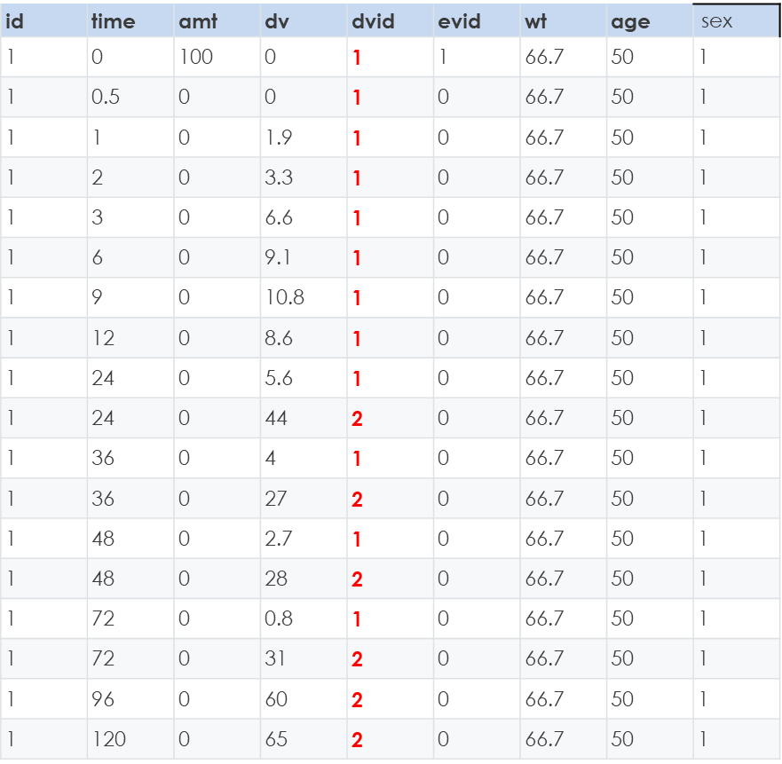
Multiple Endpoints (e.g. joint PKPD model, multiple PD endpoints)
Example: joint PKPD model
example <- function(){
ini({
.........
})
model({
........
d/dt(depot) = -ktr * depot
d/dt(gut) = ktr * depot -ka * gut
d/dt(center) = ka * gut - cl / v * center
d/dt(effect) = kin*PD -kout*effect
cp = center / v
cp ~ prop(prop.err) + add(pkadd.err) | center
effect ~ add(pdadd.err) | effect
})
}
Dataset example in NONMEM format
One error model per endpoint/compartment
Error parameters to be estimated in ini block
|compartment → needed to specify which error is for which compartment
# PK
# PD
1 = PK
2 = PD
#Data conversion to nlmixr data standard: DVID to CMT
# Read data
homedir="."
data.pkpd <- read.csv(file = paste(homedir,"warfarin_dat.csv",sep="/"))
## Convert the dvid data item to compartment names.
## The easiest way to do this is to convert it to a factor.
## Alternatively you could count the compartment number and
## assign it directly. by data.pkpd$dvid + 2
##
data.pkpd$cmt <- factor(data.pkpd$dvid,c(1,2),c("center","effect"))
Example Warfarin PKPD model:
https://github.com/nlmixrdevelopment/nlmixr-examples/tree/master/case-study-warfarin

Slide 41
Multiple Endpoints (e.g. joint PKPD model, multiple PD endpoints)
Example: multiple PD endpoints → PK model parameters were fixed in this model
example <- function(){
ini({
.........
})
model({
........
d/dt(CENTRAL) = -C1*CL + Q*(C2-C1);
d/dt(PERIF) = - Q*(C2-C1);
d/dt(RET) = KTR*PROG2*(1+EDRUG)-KRET*RET;
d/dt(RBC) = KRET*RET-KRBC*RBC;
d/dt(HGB) = KRET*RET+KRBC*RBC-KHGB*HGB;
d/dt(PROG1) = KPROL*PROG1*(2*RBC0/HGB)-KTR*PROG1;
d/dt(PROG2) = KTR*PROG1-KTR*PROG2*(1+EDRUG);
log(HGB) ~ add(logHgb) | HGB
log(RBC) ~ add(logRbc) | RBC
log(RET) ~ add(logRet) | RET
})
}
One error model per endpoint/compartment
Error parameters to be estimated in ini block
|compartment → needed to specify which error is for which compartment
Reynaldo-Fernández G. et al. Semi-mechanistic Pharmacokinetic/Pharmacodynamic model of three pegylated rHuEPO and ior®EPOCIM in New Zealand rabbits. European Journal of Pharmaceutical Sciences 120 (2018) 123–132

Slide 42
Outlook: April 2019

Slide 43
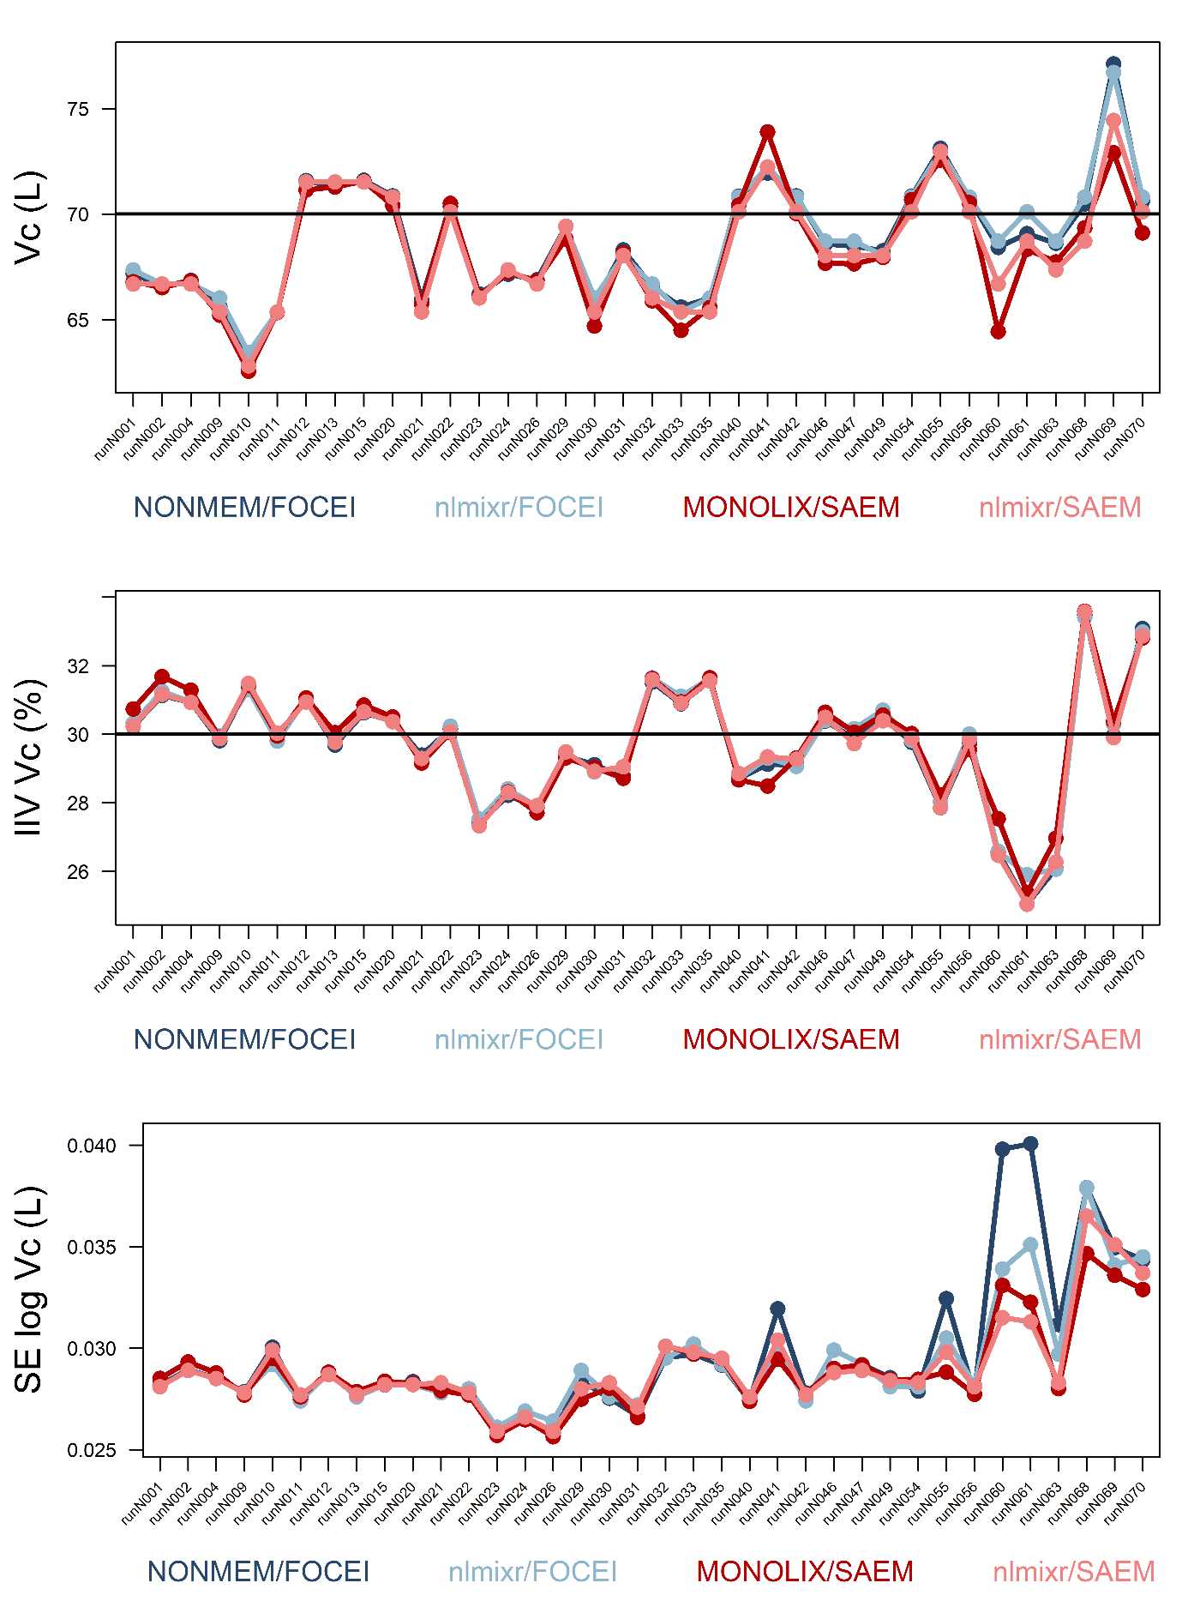
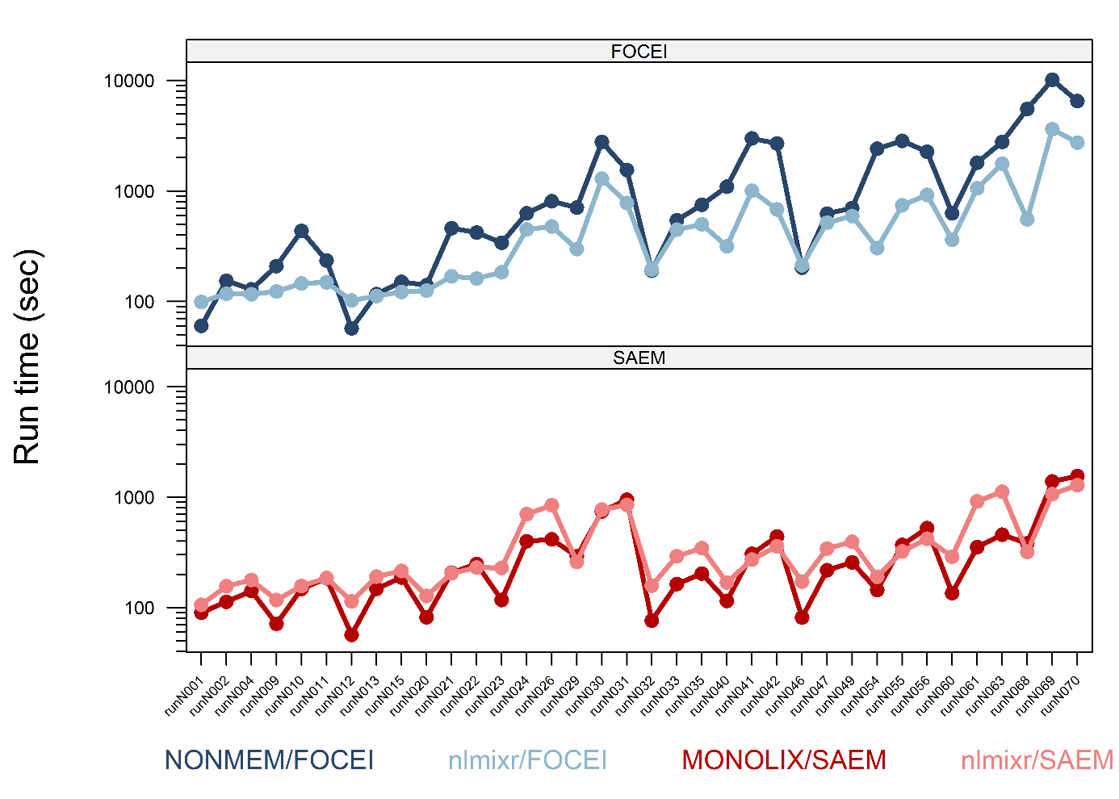
Comparison – See Poster 1356
Nlmixr SAEM has similar estimates as Monolix SAEM
Single thread run SAEM times are slower
Nlmixr FOCEi has similar estimates as NONMEM FOCEi
Single thread run FOCEi times are faster
Nlmixr is a competitive alternative to commercial offerings (with less user experience)

Slide 44
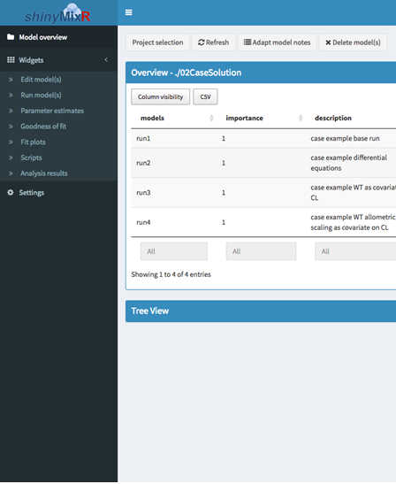


By the people: nlmixr support and add-ons
xpose interface
Justin Wilkins
GUI project management
Richard Hooijmaijers
Automatic reporting
Christian Rasmussen
GUI auto-simulator Bernard Ngara
https://github.com/UUPharmacometrics/xpose https://github.com/nlmixrdevelopment/xpose.nlmixr
https://github.com/RichardHooijmaijers/shinyMixR
http://pharmtex.org/

Slide 45

: a popPKPD tool by pharmacometricians, for pharmacometricians
Call for participation:
Testing
shinyMixR
STAN/Bayesian methods
Comparison/benchmarking (e.g. to NONMEM & Monolix)
PBPK/QSP module
nlmixr tutorials and local champions
NCA app
Contact us to participate @ nlmixr.info@gmail.com –
Or just download the source code and get stuck in!

Slide 46
Resources, documentation and further reading
Home of nlmixr, RxODE, xpose.nlmixr, support packages (most recent versions)
www.nlmixr.org
Documentation: continually evolving
https://nlmixrdevelopment.github.io/nlmixr_bookdown/
Open course material:
PAGE (Montreux, 2018): https://github.com/nlmixrdevelopment/PAGE-2018
ACoP9 (San Diego, 2018): https://github.com/nlmixrdevelopment/ACoP9-2018
Cheat sheets and posters:
https://github.com/nlmixrdevelopment/Publications
Twitter: @nlmixr
LinkedIn: https://www.linkedin.com/groups/8621368/

